Slide 1
Practical Review on Security Domains and Frameworks
Week 2: What have you learnt so far?

Slide 2
?
Last weeks review

Slide 3
Team Divisions
MERCURY
MARS
JUPITER
VENUS
SATURN
Back Wing
Left Wing
Center Wing
Right Wing
Forward Wing

Slide 4
VISIT https://forms.gle/X9ddLumBzEENH1FSA to join your team

Slide 5
Case Study Analysis
In 2013, Target, one of the largest retail companies in the U.S., experienced a massive data breach that affected over 40 million customers. The attackers gained access to the company's network through a third-party vendor. They installed malware on Target's point-of-sale (POS) systems, which allowed them to steal customers' credit and debit card information during transactions.
Questions:
How did the attackers gain initial access to Target's network?
What does this suggest about the importance of third-party vendor security?
What measures could have been taken by Target to detect and prevent the installation of malware on their POS systems?
Discuss the potential long-term consequences of this data breach on Target's brand reputation and customer trust.

Slide 6
Case Study Analysis Answers
Question 1
The attackers gained initial access to Target's network through a third-party vendor, Fazio Mechanical Services, which provided Target's HVAC (heating, ventilation, and air conditioning) services.
The attackers used stolen credentials from this vendor to access Target’s network.

Slide 7
Case Study Analysis Answers
Question 2
Target could have implemented several measures to detect and prevent the installation of malware on its POS systems.
Network Segmentation
Multi-Factor Authentication (MFA)
Intrusion Detection and Prevention Systems (IDPS)
Regular Audits and Monitoring
Endpoint Security Solutions

Slide 8
Case Study Analysis Answers
Question 3
The Target data breach had significant long-term consequences for the company's brand reputation and customer trust.
Loss of Customer Trust
Financial Impact
Regulatory Scrutiny
Reputational Damage
Long-term Security Investments

Slide 9
At the end, you should:
CYBER
Familiarize yourself with your group members
Understand the major security domains
Choose a particular domain of interest
Identify some security controls and frameworks
Explain Security Principles
CYBER
FUTURISTIC
SECURITY

Slide 10
Security Domains
01
Each team will discuss their understanding of security domains and present. (5mins/each)

Slide 11
As of 2022, CISSP defined eight domains to organize the work of security professionals.

Slide 12
Importance of Security Domains
The domains outline and organize how a team of security professionals work together.
Depending on the organization, your role may sit at the intersection of multiple domains or focus on one specific domain.
It's also important to understand the domains because it may help you better understand your career goals and your role within an organization.

Slide 13
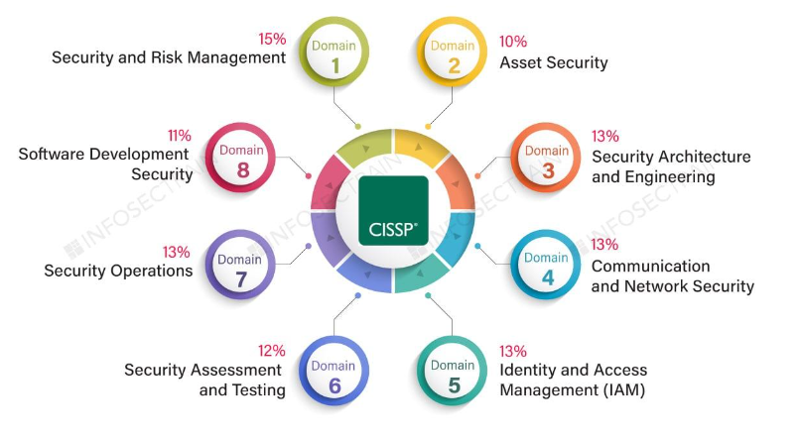
Certified Information Systems Security Professionals (CISSP) Security Domains.

Slide 14
1. Security and Risk Management
Security and risk management focuses on defining security goals and objectives, risk mitigation, compliance, business continuity, and the law.
For example, security analysts may need to update company policies related to private health information if a change is made to a federal compliance regulation such as HIPAA, such as the Health Insurance Portability and Accountability Act.

Slide 15
2. Asset Security
This domain focuses on securing digital and physical assets.
It's also related to the storage, maintenance, retention, and destruction of data.
When working with this domain, security analysts may be tasked with making sure that old equipment is properly disposed of and destroyed, including any type of confidential information.

Slide 16
3. Security Architecture
This domain focuses on optimizing data security by ensuring effective tools, systems, and processes are in place.
As a security analyst, you may be tasked with configuring a firewall.
N/B - A firewall is a device used to monitor and filter incoming and outgoing computer network traffic. Setting up a firewall correctly helps prevent attacks that could affect productivity.

Slide 17
4. Communication and network security
This domain focuses on managing and securing physical networks and wireless communications.
As a security analyst, you may be asked to analyze user behaviour within your organization.
Imagine discovering that users are connecting to unsecured wireless hotspots. This could leave the organization and its employees vulnerable to attacks.
To ensure communications are secure, you would create a network policy to prevent and mitigate exposure.

Slide 18
5. Identity and access management
Identity and access management focuses on keeping data secure, by ensuring users follow established policies to control and manage physical assets, like office spaces, and logical assets, such as networks and applications.
Validating the identities of employees and documenting access roles are essential to maintaining the organization's physical and digital security.
For example, as a security analyst, you may be tasked with setting up employees' keycard access to buildings.

Slide 19
6. Security Assessment and Testing
This domain focuses on conducting security control testing, collecting and analyzing data, and conducting security audits to monitor for risks, threats, and vulnerabilities.
Security analysts may conduct regular audits of user permissions, to make sure that users have the correct level of access.
For example, access to payroll information is often limited to certain employees, so analysts may be asked to regularly audit permissions to ensure that no unauthorized person can view employee salaries.

Slide 20
7. Security Operations
This domain focuses on conducting investigations and implementing preventative measures.
Imagine that you, as a security analyst, receive an alert that an unknown device has been connected to your internal network. You would need to follow the organization's policies and procedures to quickly stop the potential threat.

Slide 21
8. Software Development Security
This domain focuses on using secure coding practices, which are a set of recommended guidelines that are used to create secure applications and services.
A security analyst may work with software development teams to ensure security practices are incorporated into the software development life-cycle.
If, for example, one of your partner teams is creating a new mobile app, then you may be asked to advise on the password policies or ensure that any user data is properly secured and managed.

Slide 22
Maintaining an organization's security is a team effort, and there are many moving parts.
As an entry-level analyst, you will continue to develop your skills by learning how to mitigate risks to keep people and data safe.
N/B: Challenge yourself to better understand each of these domains and how they affect the overall security of an organization

Slide 23
Personally consider which domain(s) interests you

Slide 24
https://tryhackme.com/r/room/defensivesecurity
Defensive Security Practice

Slide 25
https://tryhackme.com/r/room/introtooffensivesecurity
Offensive Security Practice

Slide 26
02
Security Frameworks and Controls

Slide 27
Frameworks, Controls and Compliance
Security frameworks are guidelines used for building plans to help mitigate risks and threats to data and privacy. They have four core components:
Identifying and documenting security goals
Setting guidelines to achieve security goals
Implementing strong security processes
Monitoring and communicating results
E.g. National Institute of Standards and Technology (NIST)
Security controls are safeguards designed to reduce specific security risks. They are used alongside frameworks to ensure that security goals and processes are implemented correctly and that organizations meet regulatory compliance requirements.
Compliance is the process of adhering to internal standards and external regulations.

Slide 28
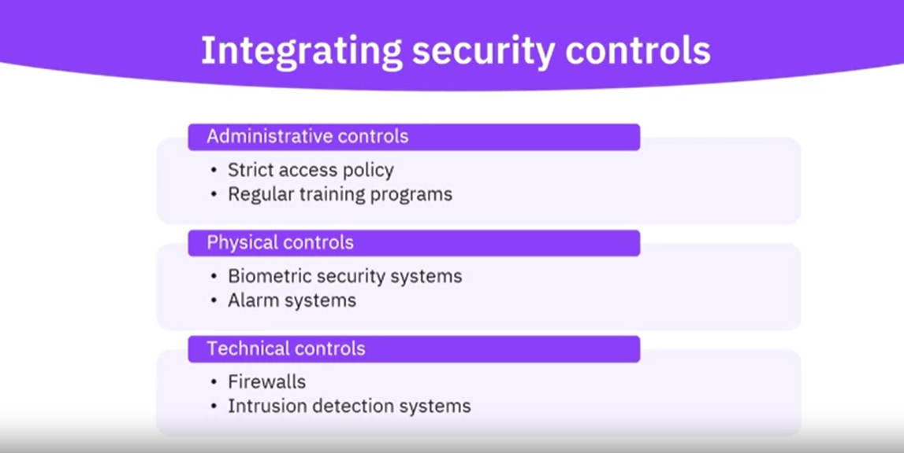
Security Controls

Slide 29
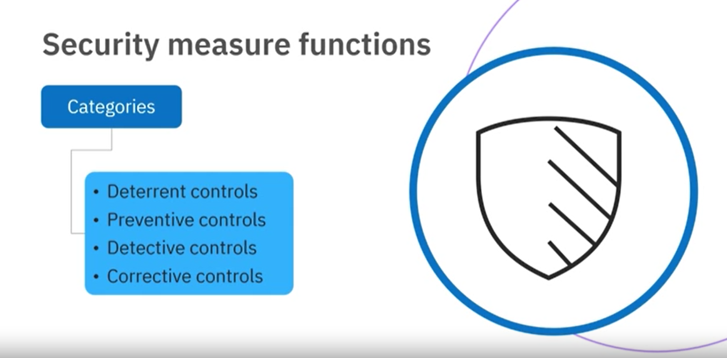
Categorizing Security Controls

Slide 30
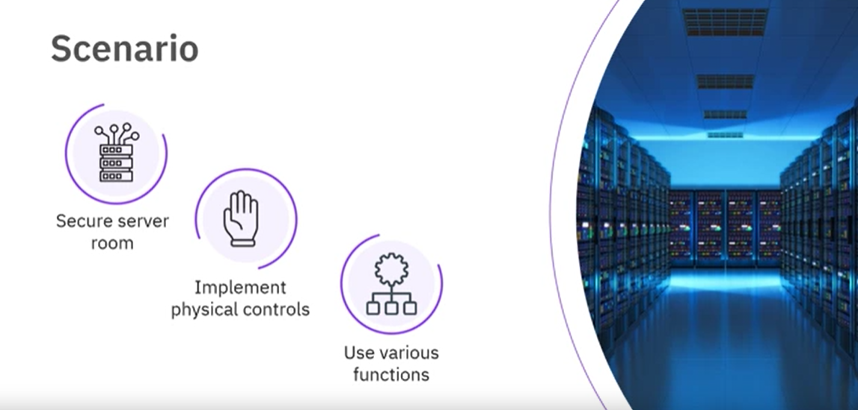
Practical Scenario

Slide 31
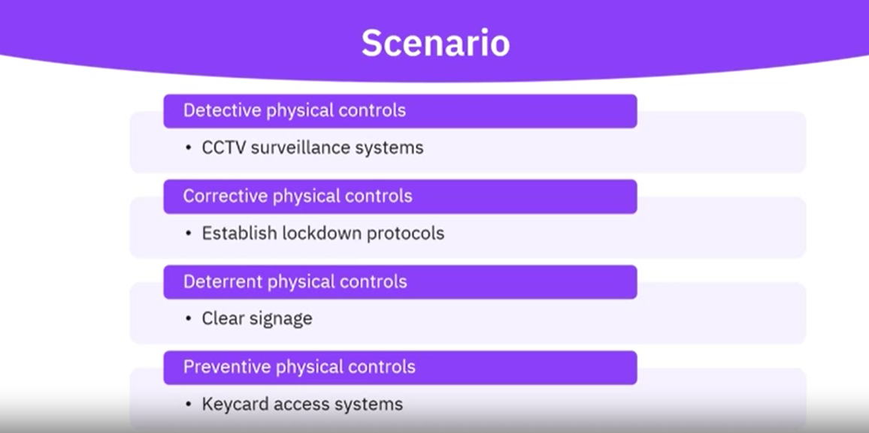
Practical Scenario

Slide 32
As a group, formulate one scenario for technical (A, B) and administrative (D, E) controls
Oracle’s Group Assignment

Slide 33

Heather’s Advice

Slide 34
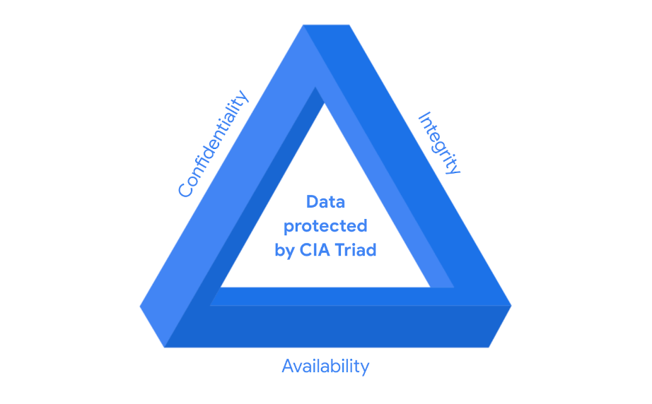
Purpose statement

Slide 35
Quick Quiz

Slide 36
A security _____ is a set of guidelines used for building plans to help mitigate risk and threats to data and privacy.
lifecycle
regulation
framework
control

Slide 37
An organization requires its employees to complete a new data privacy training program each year to reduce the risk of a data breach. This training requirement is an example of?
Security Control
Data confidentiality
Personally identifiable information (PII)
Cybersecurity Framework (CSF)

Slide 38
What is a foundational model that informs how organizations consider risk when setting up systems and security policies?
Cybersecurity Framework (CSF)
Confidentiality, integrity, and availability (CIA) triad
Sensitive personally identifiable information (SPII)
General Data Protection Regulation law (GDPR)

Slide 39
Security teams use the NIST Cybersecurity Framework (CSF) as a baseline to manage short and long-term risk.
True B. False

Slide 40
Principles of Cyber Security Architecture
03

Slide 41
Principles
Defence in depth: This principle leverages multiple security measures to protect an organization's assets. The thinking is that if one line of defence is compromised, additional layers exist as a backup to ensure that threats are stopped along the way.
Least privilege: This is an information security concept which maintains that a user or entity should only have access to the specific data, resources and applications needed to complete a required task.
Seperation of Duties: This principle prevents users from having enough privileges to misuse a system on their own.

Slide 42
Principles
Secure By Design: This principle prioritizes the security of customers as a core business requirement, rather than merely treating it as a technical feature.
Keep It Simple, Stupid: This principle promotes the use of simple, usable and straightforward security mechanisms in the making of cyber security systems architectures and logic.
Avoid
Security By Obscurity

Slide 43
Preview to Week 3
04

Slide 44
Cyber Security Tools
Python: Programming with a Purpose
Automating Security Task with Python

Slide 45
Thanks!
Do you have any questions?
amosmarvellous48@gmail.com
+234 702 625 4613

